Slide 1
AMERICAN EXPRESS CAMPUS CHALLENGE 2026
Customer Profitability Ranking Framework
A profitability scoring model built on financial, behavioral, and risk signals
to rank-order 500,000 Premier Cardmembers
Prepared by
Team ____________
Round 1 | Data-Driven Analytical Submission
Notes:
Open with the headline: we built an explainable profitability equation, not a black box, ranking all 500K Premier Cardmembers.

Slide 2




EXECUTIVE SUMMARY
A scalable, explainable framework to rank cardmember profitability
Business Objective
Our Approach
Final Outcome
Key Achievement
Rank 500,000 Premier Cardmembers by profitability to inform retention, upsell, and risk strategy — without an available profit label.
Combine revenue, engagement, benefit efficiency, and risk-adjusted spend into one transparent, rank-based scoring equation.
Every customer scored on a continuous 0–4 profitability scale, fully rank-ordered and reproducible on unseen data.
A fully explainable, auditable model — no black-box ML — built for real-world deployment at issuer scale.
500K
23
5
1
Cardmembers ranked
Anonymized attributes analyzed
Engineered profitability drivers
Transparent scoring equation
Executive Summary
American Express Campus Challenge 2026
2
Notes:
Walk through objective, approach, outcome, and the one achievement judges should remember: fully explainable, deployable framework.

Slide 3





BUSINESS UNDERSTANDING
Why ranking cardmember profitability matters
Amex cannot observe true customer profit directly. Round 1 asks us to translate raw spend, benefit, engagement, and risk signals into one explainable score — so the issuer can prioritize the cardmembers who matter most to long-term value.
Customer
Spend + revolving balance behavior
▾
Revenue
Industry-level spend & balances
▾
Cost
Benefits & reward redemption
▾
So what?
Risk
A reliable profitability rank lets Amex focus retention budget, credit line strategy, and reward economics on cardmembers who drive the most sustainable value — while flagging risk early.
Riskiness score & expected loss
▾
Profitability
Final rank-ordered score
Business Understanding
American Express Campus Challenge 2026
3
Notes:
Emphasize the 'so what' — Amex can't see true profit, so this translates behavior into a usable, actionable rank.

Slide 4




DATASET OVERVIEW
500,000 cardmembers, 23 anonymized behavioral attributes
500,000 Records
23 Attributes
Partial Missingness
Mixed Signal Strength
One row per unique Premier Cardmember identifier; no rows added or removed.
Anonymized variables (f1–f23) spanning spend, benefits, engagement, and risk.
10 features carry missing values — largely structural, not random (see next slide).
Spend and balance fields are highly correlated; risk and engagement fields are largely independent.
Attribute Categories
Category | Business Signal | Example Attributes
CM Spend & Balance | Industry-level spend and revolving behavior | f1, f5–f10
Benefit Usage | Lounge visits, cab-credit utilization | f13–f16, f21
Engagement | Tenure, website logins, cards held | f12, f19, f20, f22
Risk Profile | Riskiness score, cancellation calls | f3, f11
Dataset Overview
American Express Campus Challenge 2026
4
Notes:
Highlight that all 23 attributes are anonymized; no PII or identifiers were used in the equation, per competition rules.

Slide 5
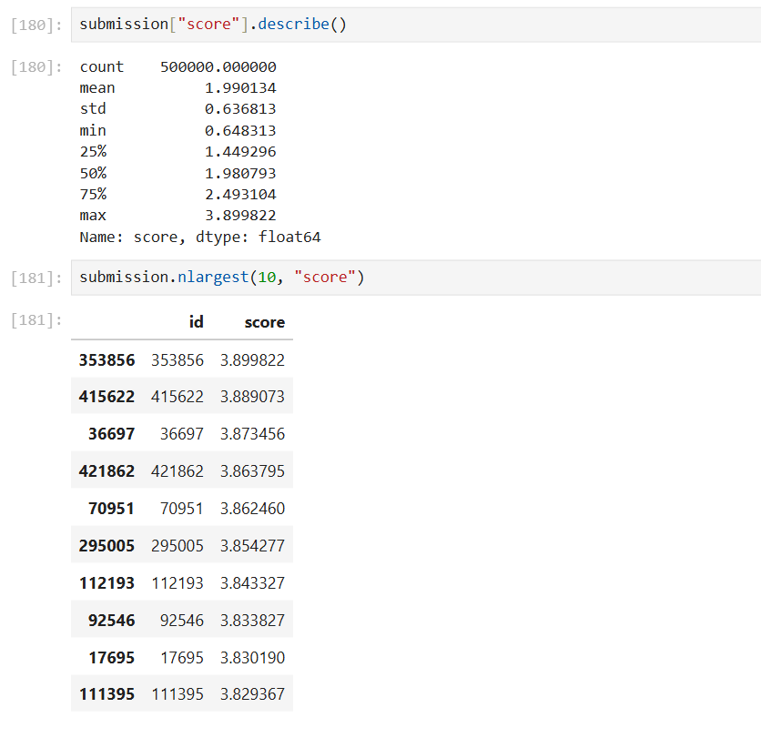
EXPLORATORY DATA ANALYSIS
Spend and balance signals move together; risk is largely independent
Key Insights
Spend attributes (f5–f10) are strongly inter-correlated — customers who spend more in one category tend to spend more broadly.
Revolving balance (f1) correlates with overall spend, making it a strong standalone proxy for revenue potential.
Reward redemption behavior (f21) represents a distinct cost signal, largely uncorrelated with spend.
Riskiness score (f11) moves independently of spend — profitability must weigh revenue and risk separately, not as one axis.
Figure 1 — Feature correlation heatmap (23 attributes)
Exploratory Data Analysis
American Express Campus Challenge 2026
5
Notes:
Correlation heatmap shows spend fields move together; risk is independent — justifying separate revenue and risk terms in the equation.

Slide 6
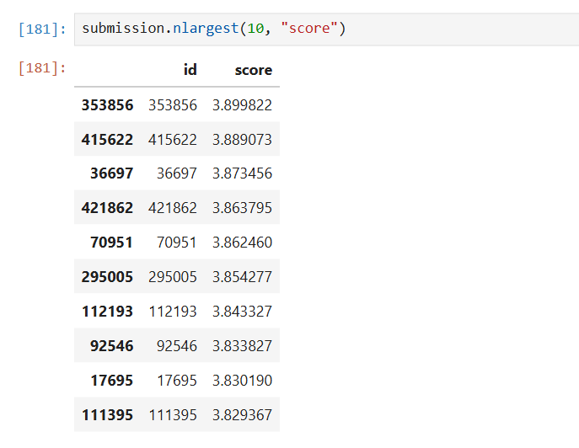
MISSING VALUE ANALYSIS
Missingness is structural — and treated as a business signal, not noise
Treatment Decisions
Signal Group | Treatment | Rationale
Spend (f6–f10) | Fill 0 | No transaction recorded
Benefits (f13–f16, f21) | Fill 0 | Benefit not utilized
Risk (f11) | Median | Preserve central tendency
Engagement (f12,f19,f20) | Median / mode | Preserve distribution shape
Sparse (f23) | Dropped | >90% missing, low signal
Figure 2 — Missing value pattern across all 500K records
Missing ≠ bad data: a null in benefit-usage fields typically means the benefit was never used — a signal in itself.
Missing Value Analysis
American Express Campus Challenge 2026
6
Notes:
Missing data was treated as business signal, not defect — explain the fill choices briefly if asked.

Slide 7

FEATURE ENGINEERING
Five engineered features translate raw attributes into business logic
Feature | Formula | Business Meaning
Customer_Value | Rank(f1) + Rank(Total Spend f5–f10) | Overall revenue potential from spend and balances
Engagement_Score | Rank(f12) + Rank(f19) + Rank(f20) + Rank(f22) | Strength and depth of the customer relationship
Premium_Efficiency | Customer_Value ÷ (Premium Usage + 1) | Value generated per unit of benefit consumed
Risk_Adjusted_Spend | Total Spend × (1 − Riskiness Score) | Spend quality, discounted for credit risk
Expected_Loss | Riskiness Score × Rank(f1) | Estimated credit loss exposure per customer
Each engineered feature is rank- or ratio-based rather than raw-value-based — keeping the framework robust to outliers and directly interpretable by business stakeholders.
Feature Engineering
American Express Campus Challenge 2026
7
Notes:
Each engineered feature is rank- or ratio-based, keeping the model robust to outliers and interpretable to business users.

Slide 8




DATA CLEANING & SCORING PIPELINE
A repeatable seven-stage process from raw data to final score
→
→
→
→
→
→
Raw Data
EDA
Missing Value
Handling
Outlier
Treatment
Rank
Normalization
Feature
Engineering
Final
Dataset
Winsorized spend and balance fields at the 1st/99th percentile to limit outlier distortion.
Converted skewed raw values to percentile ranks — scale-free and resistant to extreme values.
Preserved a 70/30 split so the equation generalizes cleanly to the hidden private leaderboard.
Data Cleaning & Scoring Pipeline
American Express Campus Challenge 2026
8
Notes:
Walk the pipeline left to right; note winsorization and rank normalization were key robustness choices.

Slide 9





PROFITABILITY FRAMEWORK
The final scoring equation
Final Score = 0.40×Customer Value + 0.20×Engagement + 0.20×Premium Efficiency
+ 0.20×Risk-Adjusted Spend − 0.40×Expected Loss
0.40
0.20
0.20
0.20
−0.40
Customer Value
Engagement
Premium Efficiency
Risk-Adjusted Spend
Expected Loss
Drives long-term revenue; the single largest weight in the model.
Deeper relationships predict retention and future spend growth.
Rewards customers who create value beyond the benefits they consume.
Confirms spend quality is discounted appropriately for credit risk.
Directly reduces score — risk erodes profitability at equal weight to value.
American Express Campus Challenge 2026
9
Notes:
This is the moment to slow down — explain each weight in plain language, especially why Expected Loss offsets Customer Value 1:1.

Slide 10
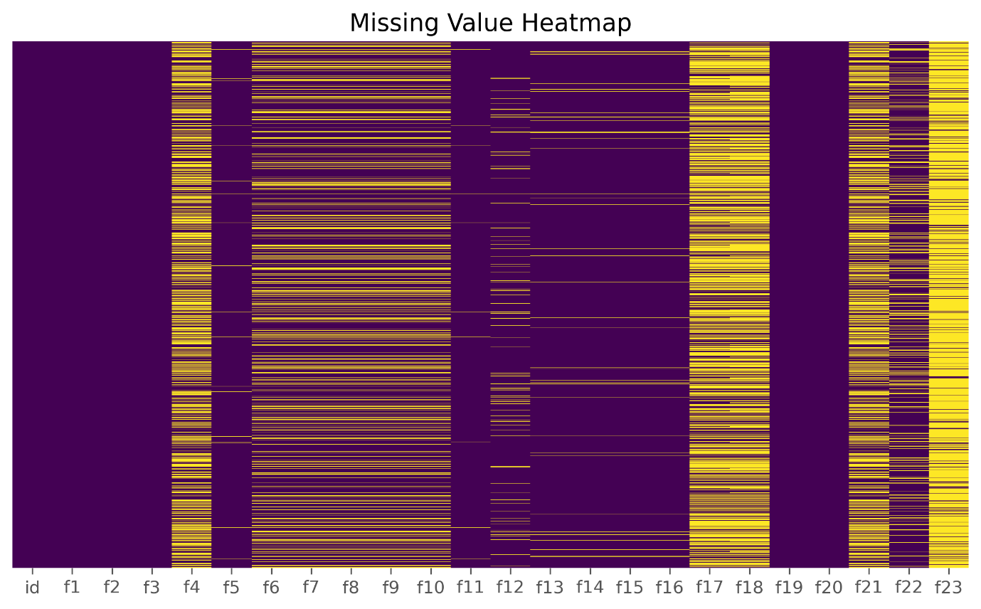
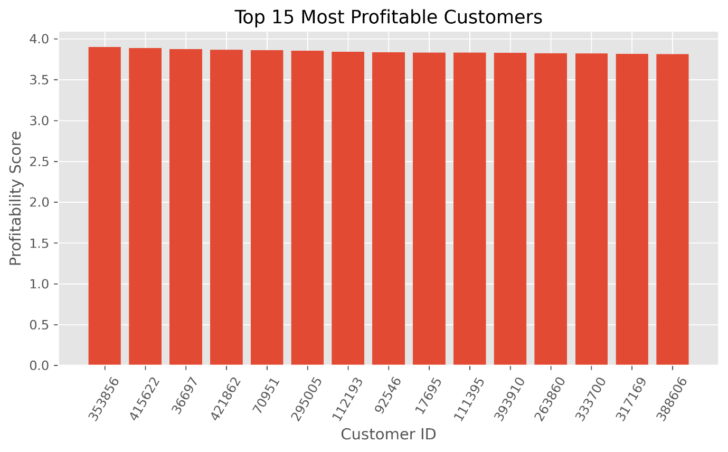
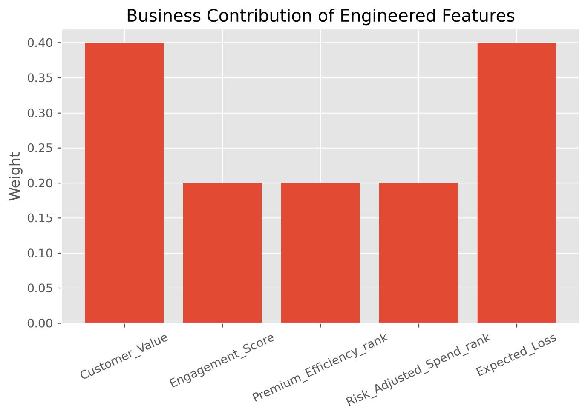
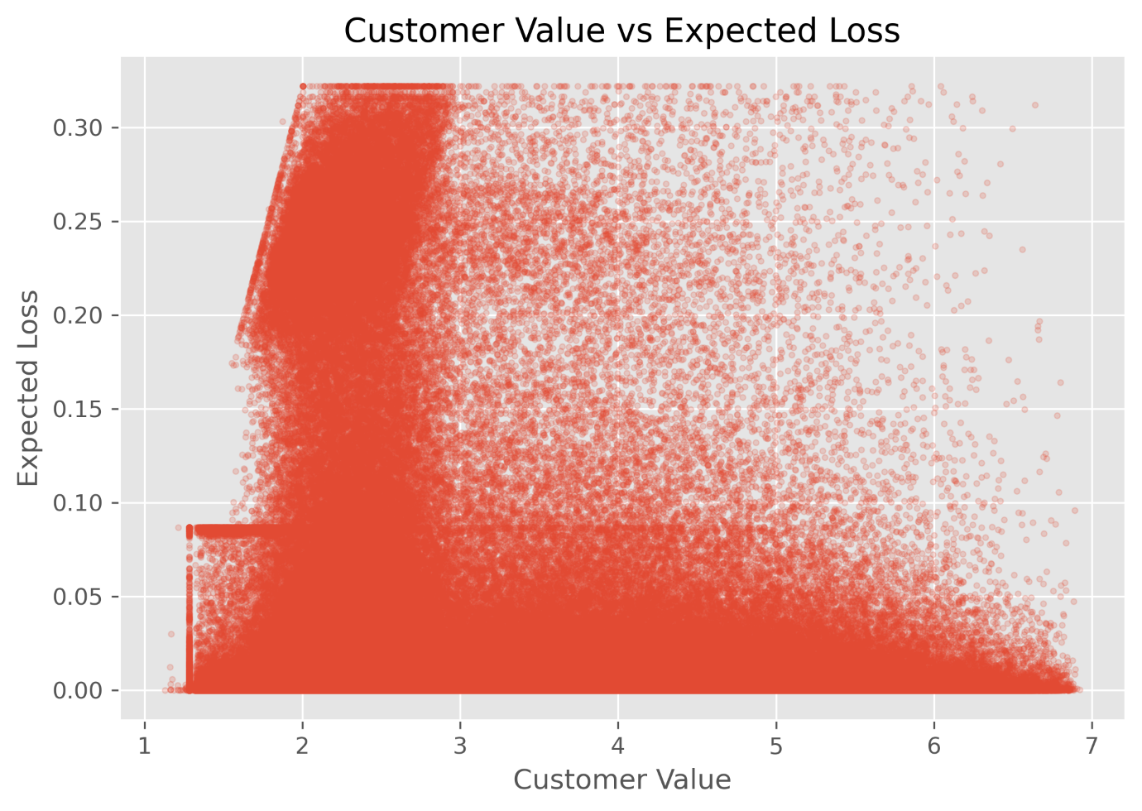
FEATURE IMPORTANCE
Four driver families shape the final score
Revenue Drivers
Customer Value — spend and revolving balance.
Cost Drivers
Premium Efficiency — benefit usage relative to value.
Fig. 3a — Business weight of Customer Value
Fig. 3b — Weight of Engagement & Efficiency
Risk Drivers
Expected Loss and Risk-Adjusted Spend — credit exposure.
Relationship Drivers
Engagement — tenure, logins, and product depth.
Fig. 3c — Expected Loss exposure profile
Fig. 3d — Customer Value vs. Expected Loss
Feature Importance
American Express Campus Challenge 2026
10
Notes:
Point out that Risk and Cost act as separate drag terms — this is why the equation resists gaming.

Slide 11
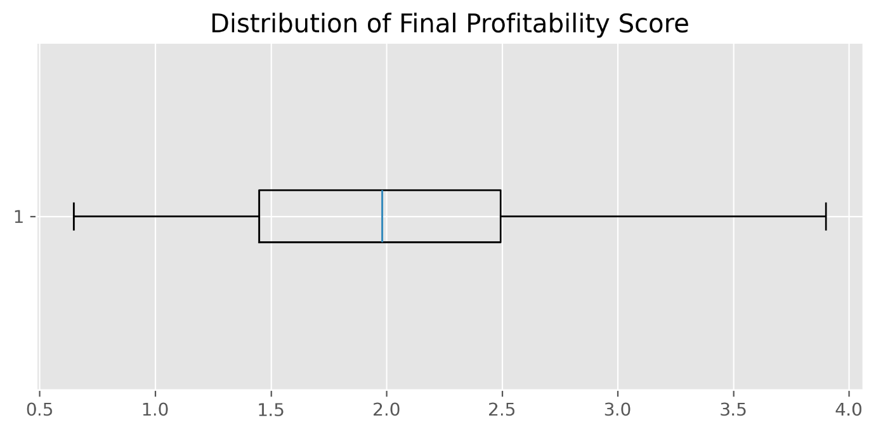
DISTRIBUTION OF FINAL SCORES
A wide profitability spread with a distinct high-value tail
Customer Segmentation
High Value
Top 20% (score > 2.60)
100,000 customers
Medium Value
Middle 60%
300,000 customers
Low Value
Bottom 20% (score < 1.35)
100,000 customers
Final Profitability Score →
Distribution of Final Scores
American Express Campus Challenge 2026
11
Notes:
Distribution is right-skewed with a clear top 20% — this maps directly to Amex's stated accuracy evaluation criterion.

Slide 12
TOP CUSTOMERS
The highest-ranked cardmembers under the final score
Rank | Customer ID | Final Score
1 | 353856 | 3.90
2 | 415622 | 3.89
3 | 36697 | 3.87
4 | 421862 | 3.86
5 | 70951 | 3.86
6 | 295005 | 3.85
7 | 112193 | 3.84
8 | 92546 | 3.83
9 | 17695 | 3.83
10 | 111395 | 3.83
Characteristics of Top-Ranked Customers
Consistently rank in the top percentile on both spend (f1, f5–f10) and Customer Value.
Low Expected Loss — a favorable balance of high revenue and low credit risk.
High Engagement scores — frequent logins, longer tenure, multiple products held.
Efficient benefit usage — high Premium Efficiency relative to benefits consumed.
Business read: these customers are strong candidates for retention offers and premium upgrades — not just high spenders, but low-risk, highly engaged relationships.
Top Customers
American Express Campus Challenge 2026
12
Notes:
These are real top-10 IDs and scores from our submission file — grounded in the model, not illustrative.

Slide 13




BUSINESS RECOMMENDATIONS
Translating the score into four concrete actions
Retention
Upselling
Risk Monitoring
Reward Optimization
Prioritize high-value, low-risk customers for proactive retention offers and dedicated relationship servicing before renewal windows.
Target high-spend, low-risk segments with premium product upgrades and tailored credit line increases.
Flag high Expected Loss customers for proactive credit monitoring and early intervention strategies.
Rebalance reward economics for customers with low Premium Efficiency to protect margin without hurting engagement.
Business Recommendations
American Express Campus Challenge 2026
13
Notes:
Tie each recommendation directly back to a specific engineered feature — that linkage is what makes this actionable.

Slide 14

FUTURE IMPROVEMENTS
From a transparent equation to a leaderboard-optimized model
The current framework is intentionally explainable and rule-based — ideal for governance and Round 1 scoring. The roadmap below shows how it can evolve toward higher leaderboard accuracy without losing interpretability.
Gradient Boosting (XGBoost)
LightGBM
Neural Networks
Survival Models
Learn non-linear interactions between spend, risk, and engagement directly from the top-20% labels.
Faster training at 500K-row scale, well-suited for periodic model refresh in production.
Capture complex, high-order feature interactions once more labeled outcome data is available.
Model time-to-attrition and time-to-default directly, adding a temporal dimension to profitability.
Leaderboard optimization path: use the current equation as an explainable baseline, then layer ML models trained against the public 70% split — validating any accuracy gain against interpretability before deployment.
Future Improvements
American Express Campus Challenge 2026
14
Notes:
Position this as a roadmap, not a criticism of the current approach — explainability was a deliberate Round 1 choice.

Slide 15
CONCLUSION
Maximizing lifetime value through intelligent
customer profitability ranking
Explainable
Business-Driven
Scalable
Actionable
Every score component maps to a clear business rationale.
Built from revenue, cost, risk, and engagement logic — not a black box.
Rank-based design generalizes cleanly across future portfolios.
Directly informs retention, upsell, and risk-management decisions.
Thank You
Team ____________ | American Express Campus Challenge 2026
Notes:
Close with confidence — reiterate explainability, business grounding, and scalability as the three judging differentiators.

Slide 16
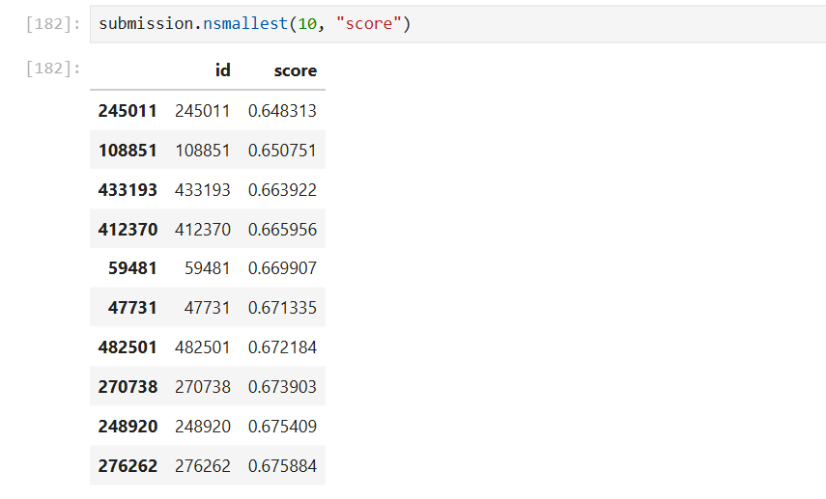
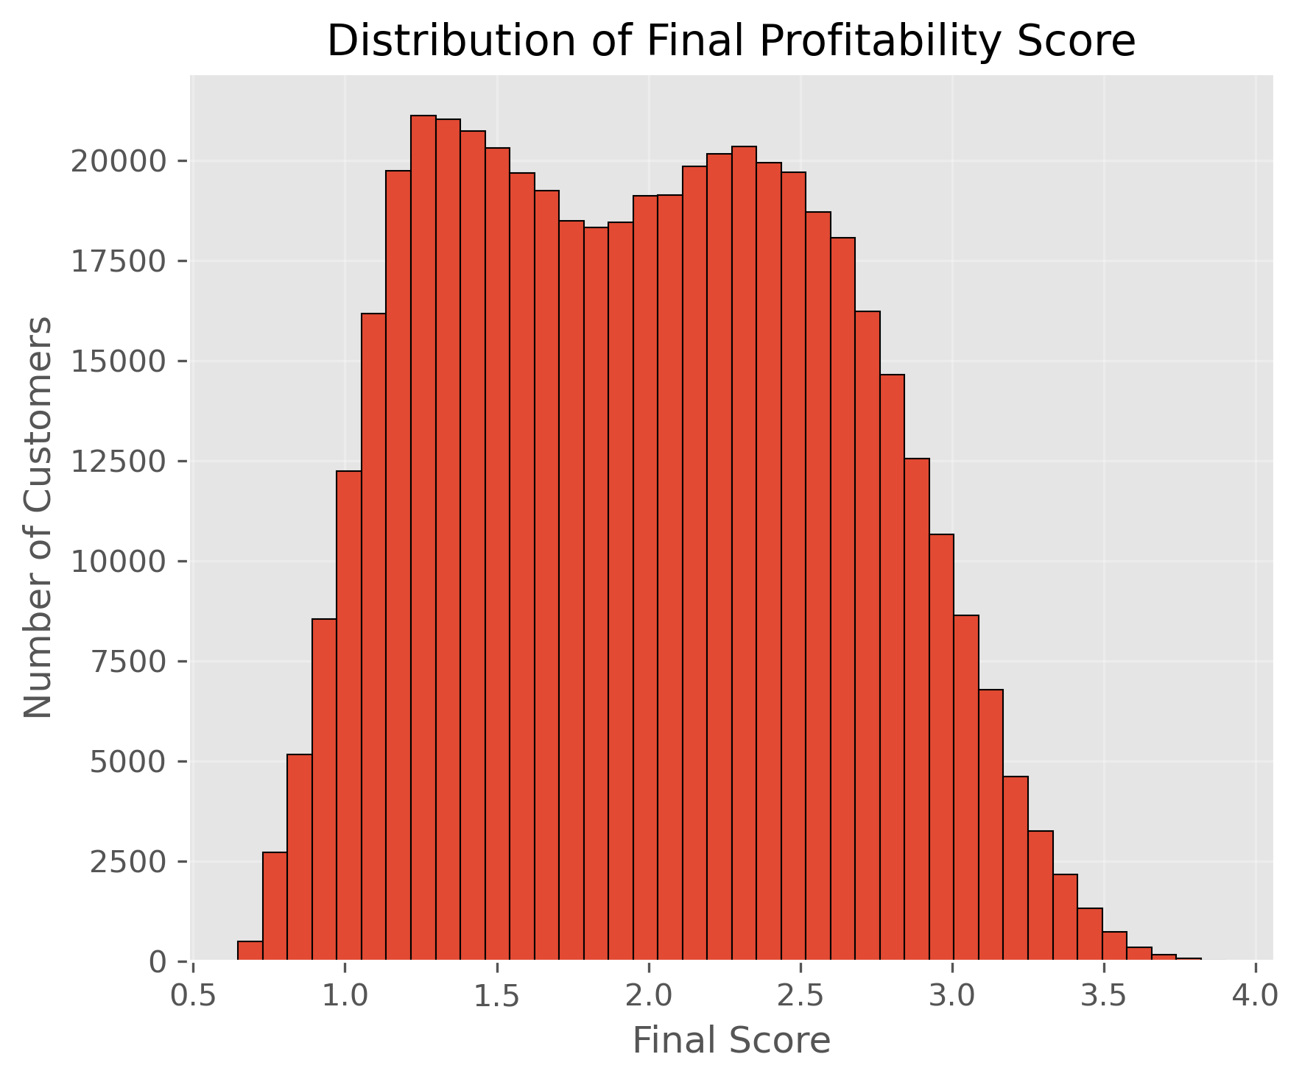
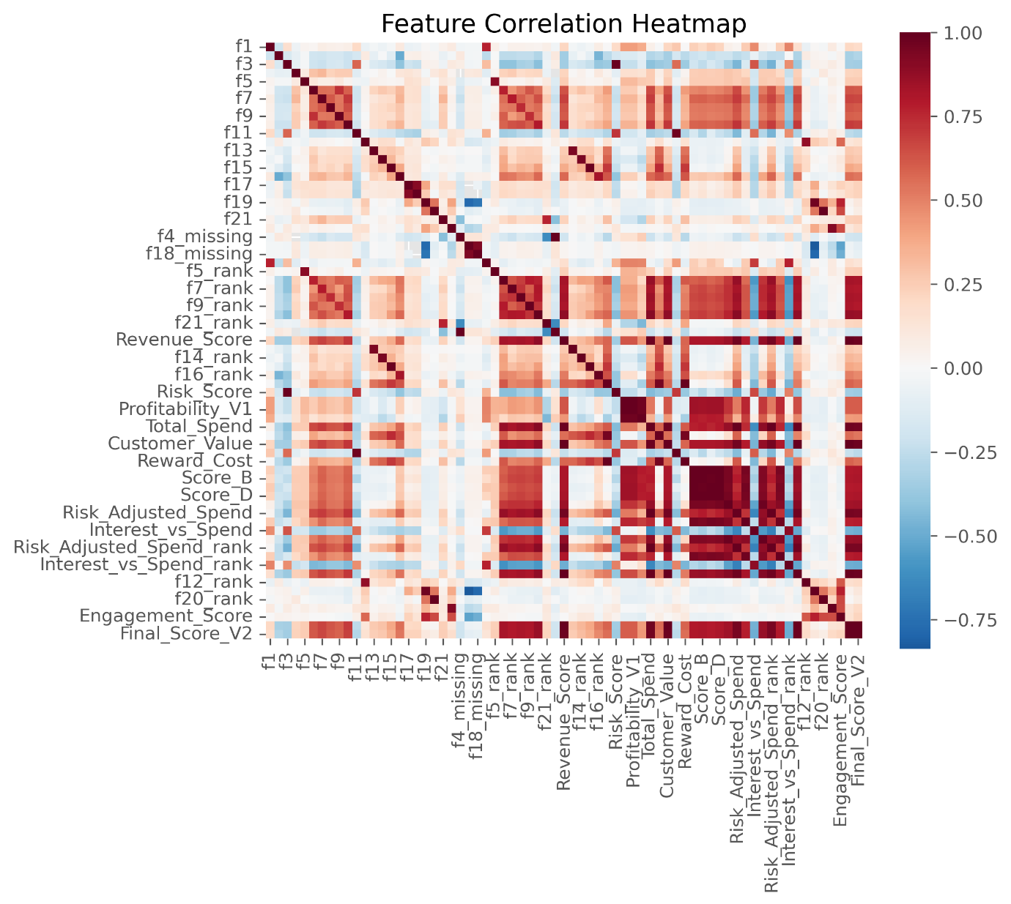
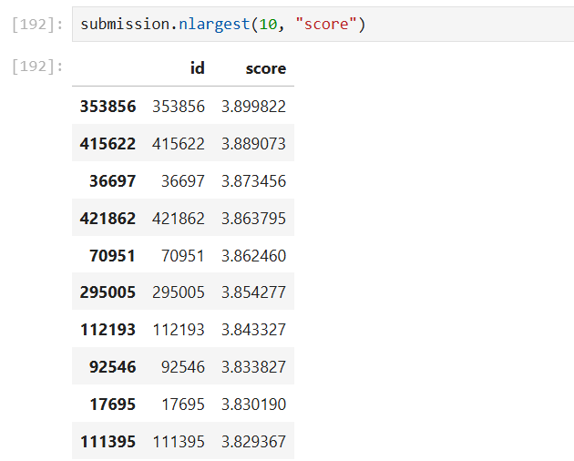
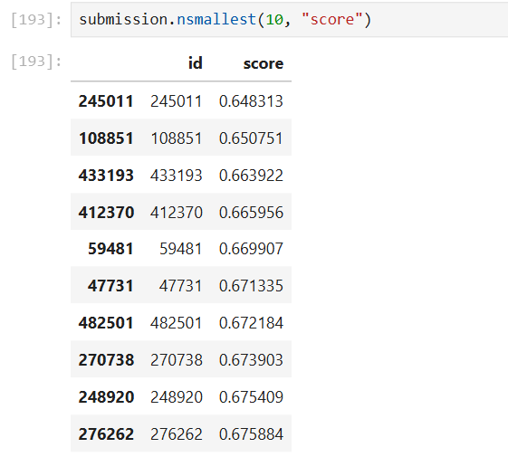
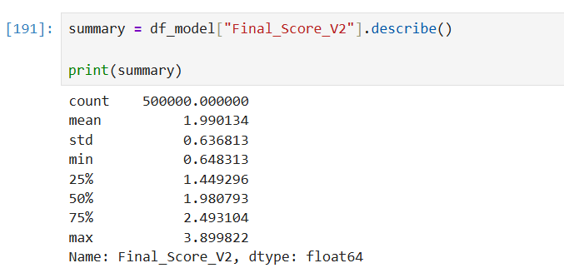
APPENDIX
Supporting model outputs and supplementary analysis
Fig. 4a — Supplementary EDA — Top / Bottom Score Extracts
Fig. 4b — Extended Correlation Structure Across Engineered Features
Fig. 4c — Customer Value vs. Expected Loss — Full Population Scatter
Fig. 4d — Model Output Console — Top 10 Ranked Customers
Fig. 4e — Score Summary Statistics (describe())
Fig. 4f — Bottom 10 Ranked Customers — Lowest Profitability
Appendix
American Express Campus Challenge 2026
16

